Slide 1
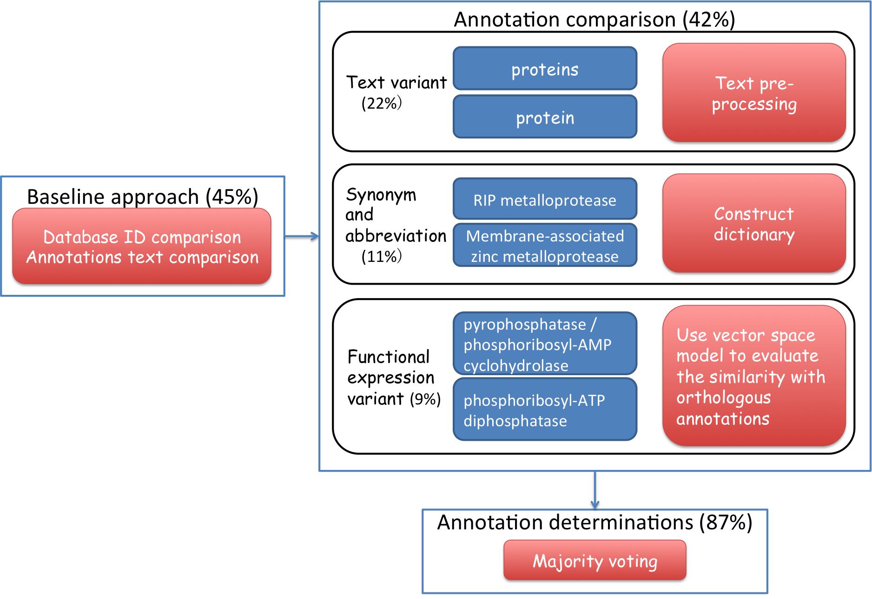

A bacterial automated annotation pipeline
Rationale
Workflow
Text variant | cAMP-binding proteins - catabolite gene activator and regulatory subunit of cAMP-dependent protein kinases | putative cAMP-binding protein - catabolite protein activator and regulatory subunit of cAMP-dependent protein kinase
Synonym and abbreviation | RIP metalloprotease | Membrane-associated zinc metalloprotease
Function expression variant | transformation system protein | Predicted amidophosphoribosyltransferases
Cross species annotation comparison
Cross species annotation determination

Slide 2
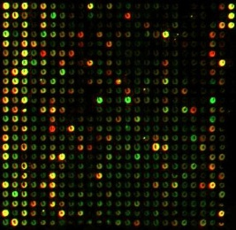
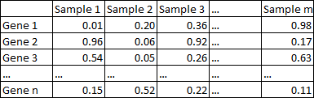
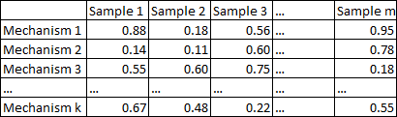
Rheumatoid Arthritis patient subtyping
Workflow
Gene level subtyping
Pre-processing
Western European cohort (single colour array)
Japanese cohort (customized two colour array)
Mechanism
level analysis
Gene level analysis
Top 5000 most variant probes
Gene by sample matrix
Pathway activity: PLAGE
Filtering: Top 500 most variant mechanisms
MsigDB C2
1. Consensus clustering
2. Silhouette plot
3. BIC plot
4. CH plot
Mechanism by sample matrix
1. Consensus clustering
2. Silhouette plot
3. Discriminative pathways
Wilkerson, M D et al 2010
Heatmap results
Pathway level subtyping
Genomics (in revision)

Slide 3
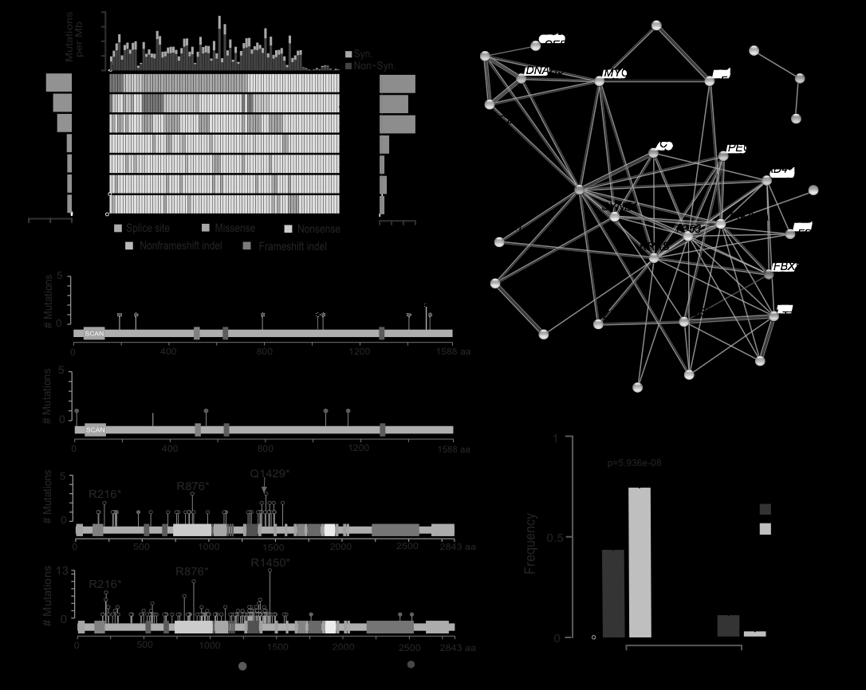
Chinese CRC whole exome sequencing
Sequencing statistics
Significantly mutated genes
Mutation spectrum
Significantly mutated pathways
Oncotarget (in revision)

Slide 4
Conclusions
Gene expression
Pre-processing (microarray and RNA-Seq)
Large scale data clustering and classification
Genome, genetics
Whole exome sequencing

Slide 5
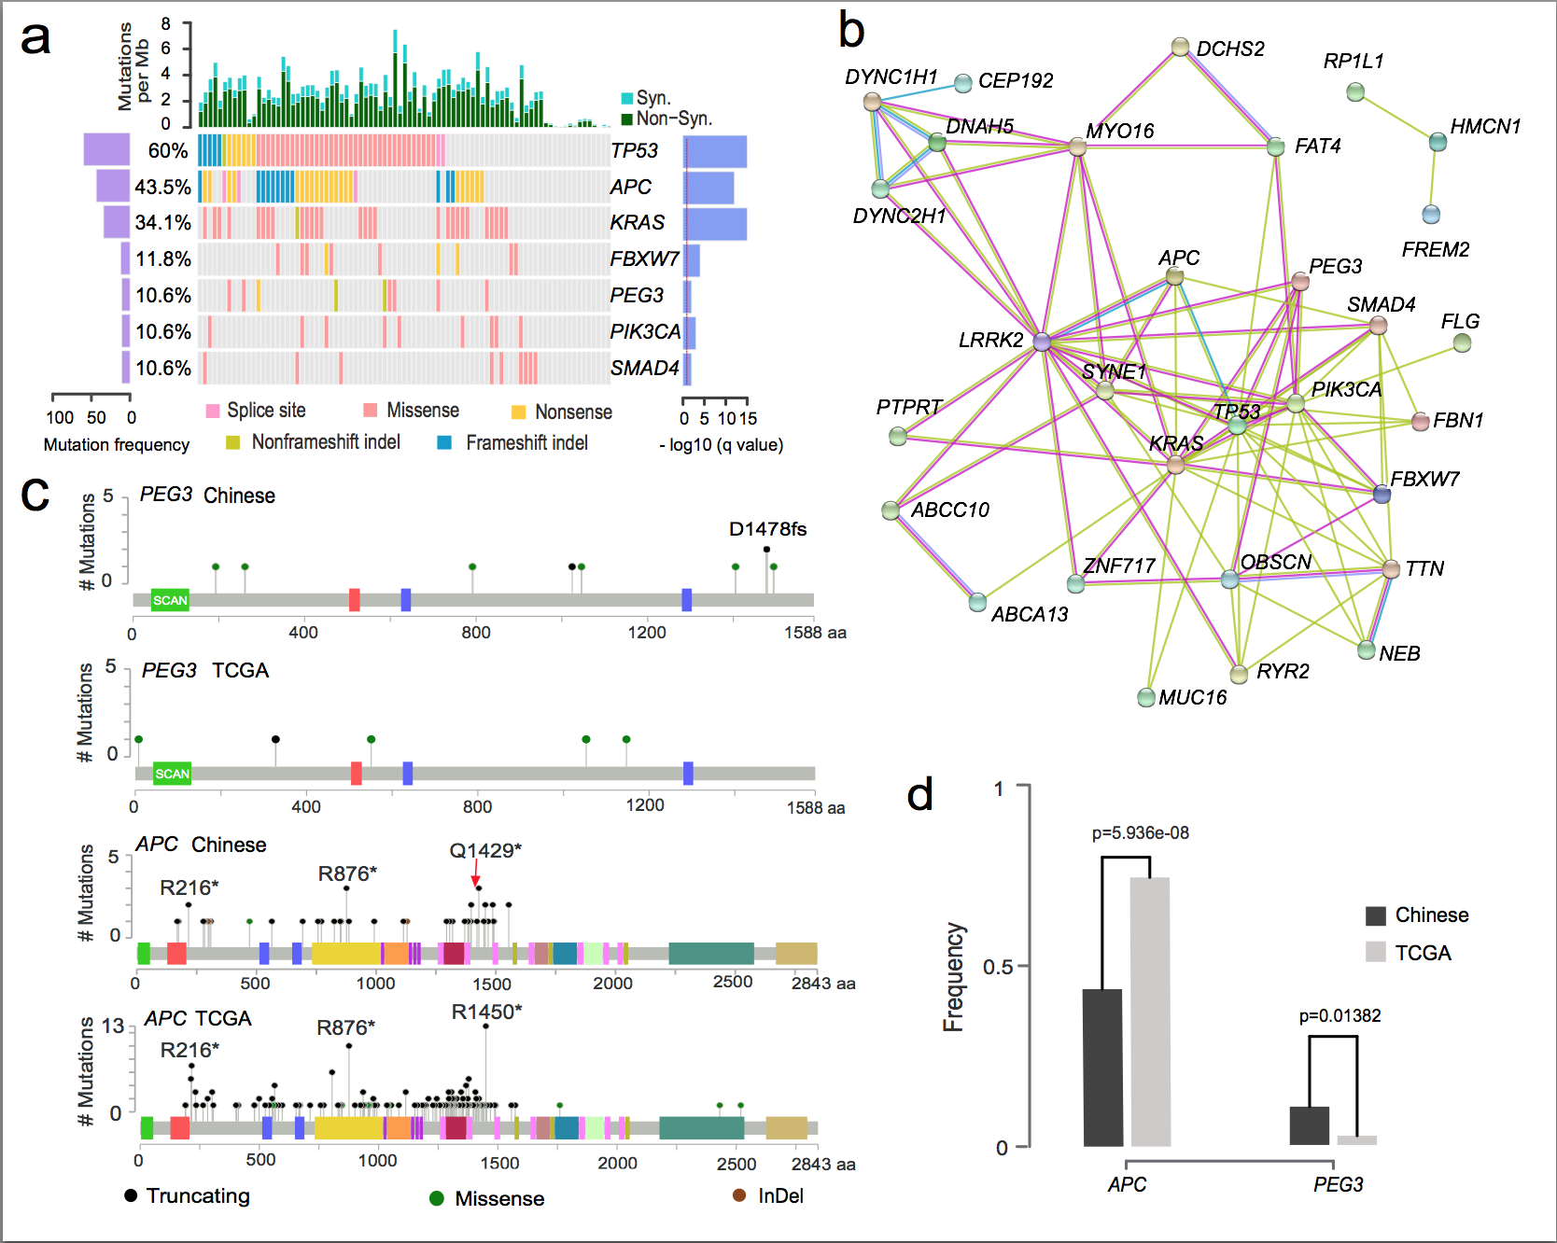
Chinese CRC whole exome sequencing
测序数据
显著性突变基因
突变频谱
显著性突变通路
Oncotarget (一作、在修)

Slide 6
Rheumatoid Arthritis patient subtyping
流程图
基因水平分群结果
Pre-processing
Western European cohort (single colour array)
Japanese cohort (customized two colour array)
Mechanism
level analysis
Gene level analysis
Top 5000 most variant probes
Gene by sample matrix
Pathway activity: PLAGE
Filtering: Top 500 most variant mechanisms
MsigDB C2
1. Consensus clustering
2. Silhouette plot
3. BIC plot
4. CH plot
Mechanism by sample matrix
1. Consensus clustering
2. Silhouette plot
3. Discriminative pathways
Wilkerson, M D et al 2010
通路水平分群结果
热图结果
Genomics (一作、在修)

Slide 7
自动化的微生物基因组注释
基因组注释问题
流程图
Text variant | cAMP-binding proteins - catabolite gene activator and regulatory subunit of cAMP-dependent protein kinases | putative cAMP-binding protein - catabolite protein activator and regulatory subunit of cAMP-dependent protein kinase
Synonym and abbreviation | RIP metalloprotease | Membrane-associated zinc metalloprotease
Function expression variant | transformation system protein | Predicted amidophosphoribosyltransferases
跨物种基因注释比较结果
跨物种基因注释决定结果
BMC Bioinformatics (一作、发表)

Slide 8
总结
基因表达数据
Microarray和RNA-Seq数据的预处理
大样本数据的聚类和分群分析
基因组和遗传学数据
全外显子组数据

